Slide 1
Channel Coding For Error Control and Security
Prof.Cheruiyot W.K
JKUAT, SCIT
Computing Department

Slide 2
Introduction
The fundamental resources at the disposal of a communications engineer are signal power, time and bandwidth.
For a given communications environment, these three resources can be traded against each other.

Slide 3
A general objective, however, is often to achieve maximum data transfer, in a minimum bandwidth while maintaining an acceptable quality of transmission.
The quality of transmission, in the context of digital communications, is essentially concerned with the probability of bit error, Pe, at the receiver.

Slide 4
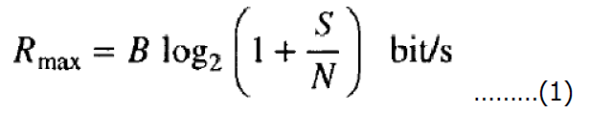
The Shannon-Hartley law
It shows (quantitatively) how bandwidth (B) and signal power (S/N) may be traded in an ideal system, and
It also gives a theoretical limit for the transmission rate of (reliable, i.e. error free) data (Rmax) from a transmitter of given power, over a channel with a given bandwidth, operating in a given noise environment.

Slide 5
In order to realize this theoretical limit, however, an appropriate coding scheme (which the Shannon-Hartley law assures us exists) must be found.
In practice, the objective of the design engineer is to realize the required data rate (often determined by the service being provided) within the bandwidth constraint of the available channel and the power constraint of the particular application.

Slide 6
For a fixed S/N, the only practical option available for changing data quality from problematic to acceptable is to use error-control coding.
Another practical motivation for the use of coding is to reduce the required S/N for a fixed bit error rate.
The reduction in S/N may, in turn, be exploited to reduce the required transmitted power or reduce the hardware costs by requiring a smaller antenna size in the case of radio communications.

Slide 7
Moreover, the use of error-control coding adds complexity to the system, especially for the implementation of decoding operations in the receiver.
Thus, the design trade-offs in the use of error-control coding is to achieve acceptable error performance include considerations of bandwidth and system complexity.
The design goal of channel coding is to increase the resistance of a digital communication system to a channel noise. Error control coding is used to detect and often correct symbols which are received in error.

Slide 8
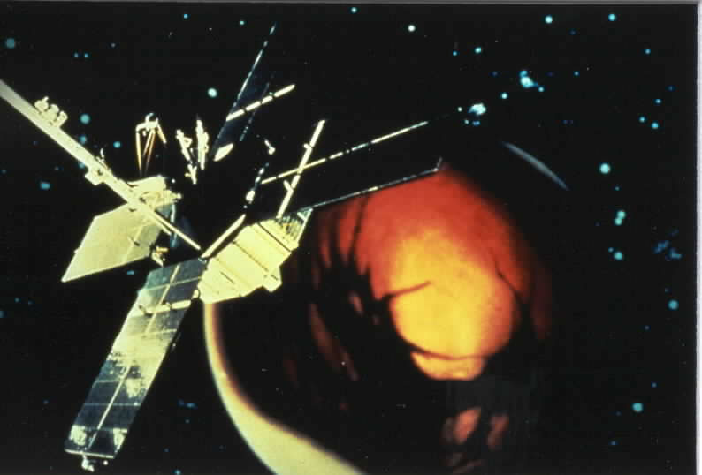
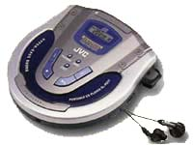
What is Coding Theory?
Coding theory is the study of error-control codes
Error control codes are used to detect and correct errors that occur when data are transferred or stored

Slide 9
What is Coding Theory?
A mix of mathematics, computer science, electrical engineering, telecommunications
  Linear algebra
  Abstract algebra (groups, rings, fields)
  Probability&Statistics
  Signals&Systems
  Implementation issues
  Optimization issues
  Performance issues

Slide 10
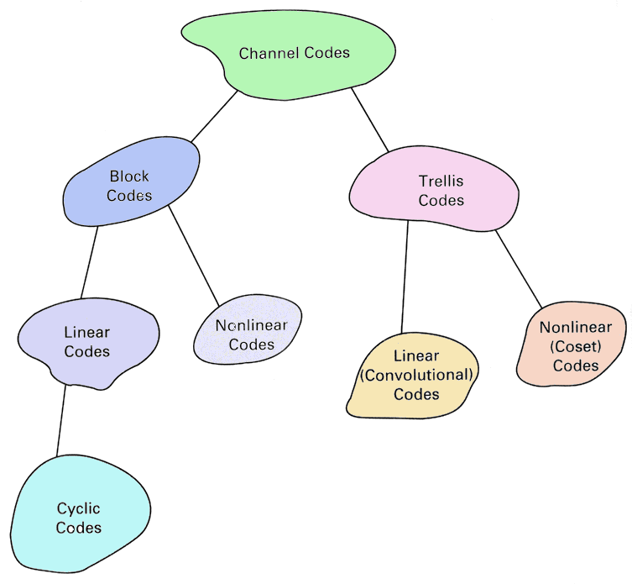
A code taxonomy

Slide 11
General Problem
We want to send data from one place to another…
  channels: telephone lines, internet cables, fiber-optic lines, microwave radio channels, cell phone channels, etc.
or we want to write and later retrieve data…
  channels: hard drives, disks, CD-ROMs, DVDs, solid state memory, etc.
BUT! the data, or signals, may be corrupted
  additive noise, attenuation, interference, jamming, hardware malfunction, etc.

Slide 12
General Solution
Add controlled redundancy to the message to improve the chances of being able to recover the original message
Trivial example: The telephone game

Slide 13
Error-control coding: basics of Forward Error Correction (FEC) channel coding
Coding is used for error detection and/or error correction
Coding is a compromise between reliability, efficiency, equipment complexity
In coding, extra bits are added for data security
Error correction can be realized by two approaches
  ARQ (automatic repeat request)
    stop-and-wait
    go-back-N
    selective repeat
  FEC (forward error coding)
    block coding
    convolutional coding
ARQ includes also FEC
Implementations, hardware structures

Slide 14
What is channel coding?
Coding is mapping of binary source (usually) output sequences of length k into binary channel input sequences n (>k)
A block code is denoted by (n,k)
Binary coding produces 2^{k} codewords of length n. Extra bits in codewords are used for error detection/correction
We can differentiate between two coding types: (1) block, and (2) convolutional codes realized by binary numbers:
  Block codes: mapping of information source into channel inputs done independently: Encoder output depends only on the current block of input sequence
  Convolutional codes: each source bit influences n(L+1) channel input bits. n(L+1) is the constraint length and L is the memory depth. These codes are denoted by (n,k,L).
k-bits
(n,k)
block coder
n-bits

Slide 15


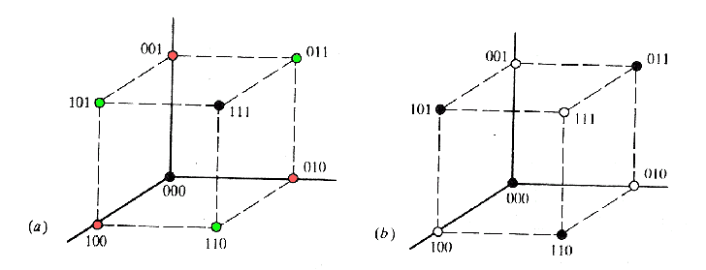
Representing codes by vectors
Code strength is measured by Hamming distance that tells how different code words are:
  Codes are more powerful when their minimum Hamming distance d_{min} (over all codes in the code family) is large
Hamming distance d(X,Y) is the number of bits that are different between code words
(n,k) codes can be mapped into n-dimensional grid:
valid code word

Slide 16

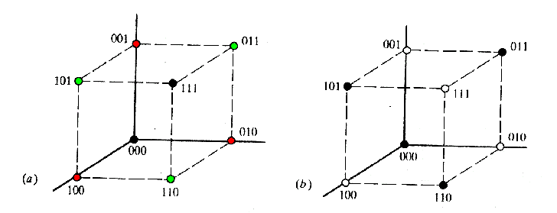



Hamming distance: The decision sphere interpretation
Consider two block code (n,k) words c₁ and c₂ at the Hamming distance in the n-dimensional code space:
It can be seen that we can detect l=d_{min}-1 errors in the code words. This is because the only way to NOT to detect the error is that the error completely transforms the code into another code word. This requires the change of at least dmin code bits. Therefore the error detection upper bound is dmin-1.
Also, we can see that we can correct t=(d_{min}-1)/2 errors. If more errors occur, the received word may fall into the decoding sphere of another code word (see the above figure).

Slide 17


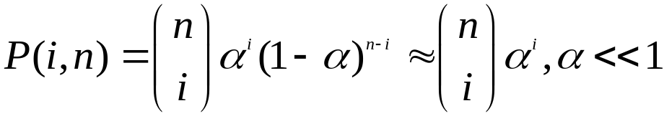


Example: repetition coding
In repetition coding, bits are repeated several times
Can be used for error correction or detection
For (n,k) block codes that is a bound achieved by repetition codes. Code rate is anyhow very small
Consider for instance (3,1) repetition code, yielding the code rate
(ie k=1, n=3)
Assume binomial error distribution, the bit error rate is:
Encoded word is formed by the simple coding rule:
Code is decoded by majority voting, e.g. for instance:
Error in decoding is introduced if all the bits are inverted or two bits are inverted (by noise or interference), e.g. majority of bits is in-error

Slide 18
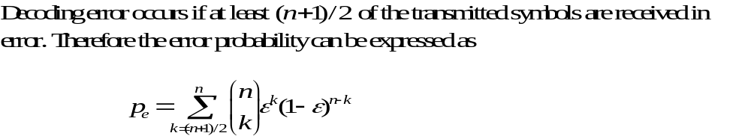
Repetition coding, cont.
In a three bit code word
  one error can be corrected always, because majority voting can detect and correct one code word bit error always
  two errors can be detected always, because all code words must be all zeros or all ones (but now the encoded bit can not be recovered)
Example:

Slide 19
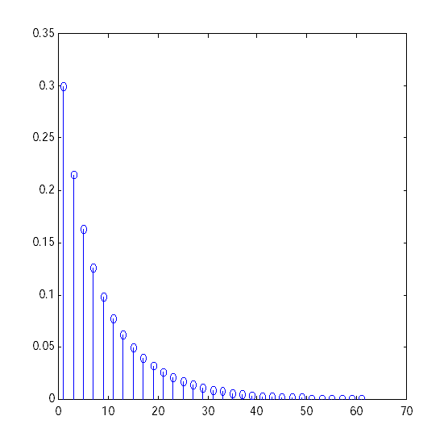
Error rate for a simple repetitive code
error rate p_{e}
Note that by increasing word length
more and more resistance to channel
introduced errors is obtained.
code length n
n

Slide 20
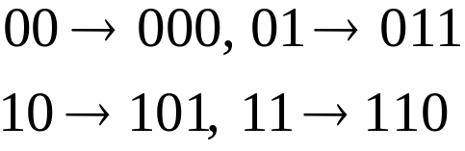
Parity-check coding
In parity-check coding a check bit is formed that indicates number of “1” in the word to be encoded.
Even number of “1” means that the encoded word has even parity
Example: coding 2-bit words by even parity is realized by
It must be noted that parity checking is very efficient method of error detection.
Therefore parity-check coding is very popular coding method of channel coding.

Slide 21

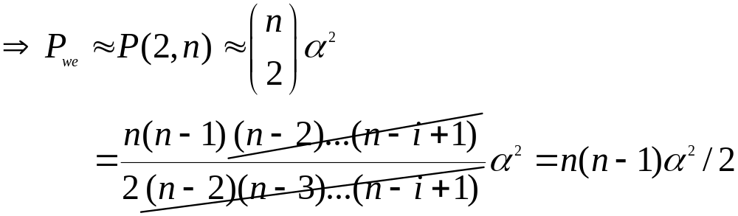
Parity-check error probability
Note that the error is not detected if even number of errors have happened
Assume n-1 bit word parity coding, e.g. (n,n-1) code. Probability to have error in a code word:
  single error can be detected (parity changed)
  probability for two-bit error is P_{we}=P(2,n), for general case:
  and note that for having more than two bit errors is highly unlikely and thus we approximate total error probability by

Slide 22





Examples of block codes: a summary
(n,1) Repetition codes. High coding gain, but low rate
(n,k) Hamming codes. Minimum distance always 3. Thus can detect 2 errors and correct one error. n=2^{m}-1, k = n - m
Maximum length codes. For every integer there exists a maximum length code (n,k) with n = 2^{k} - 1,d_{min} = 2^{k-1}
Golay codes. The Golay code is a binary code with n = 23, k = 12, d_{min} = 7. This code can be extended by adding an extra parity bit to yield a (24,12) code with d_{min} = 8. Other combinations of n and k have not been found.
BCH-codes. For every integer there exist a code with n = 2^{m}-1,
and where t is the error correction capability
(n,k) Reed-Solomon (RS) codes. Works with k symbols that consists of m bits that are encoded to yield code words of n symbols. For these codes and
Nowadays BCH and RS are very popular due to large d_{min}, large number of codes, and easy generation

Slide 23
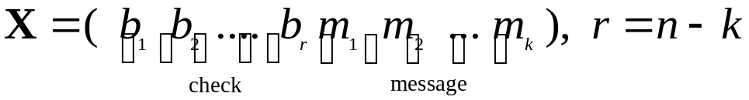

Generating block codes: Systematic block codes
In (n,k) block codes each sequence of k information bits is mapped into a sequence of n (>k) channel inputs in a fixed way regardless of previous information bits
The formed code family should be selected such that the code minimum distance is as large as possible -> high error correction or detection capability
Definition: A systematic block code:
  the first k elements are the same as the message bits
  the following r = n - k bits are the check bits
Therefore the encoded word is
or as the partitioned representation

Slide 24


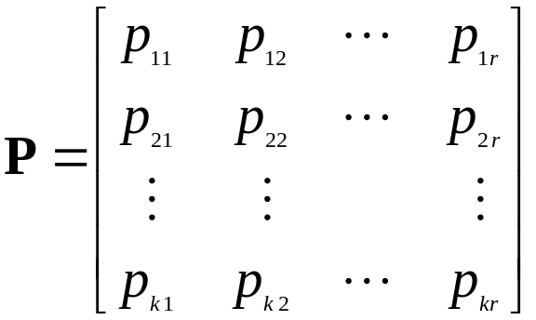

Block codes by matrix representation
Given the message vector M, the respective linear, systematic block code X can be obtained by the matrix multiplication by
The matrix G is the generator matrix with the general structure
where I_{k} is kxk identity matrix and
P is called hamming code (or called parity check matrix), it is a kxr binary submatrix ultimately determining the generated codes
On the other hand, we know:
P is Important!

Slide 25
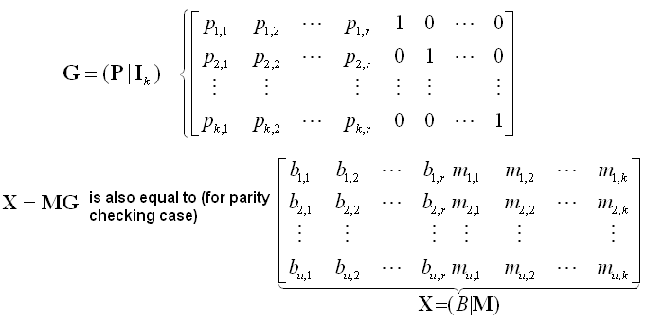
Generating block codes
For u message vectors M (each consisting of k bits) the respective n-bit block codes X are therefore determined by
One of the messages; total: u different messages.
B: NEW Appended error detection codes for the first message (also called Generated check bits)

Slide 26

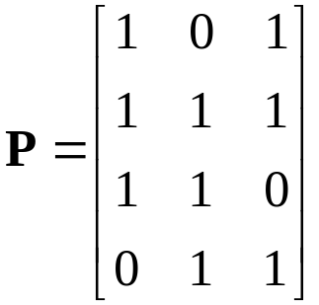
Forming the P matrix
The check vector B that is appended to the message in the encoded word is thus determined by the multiplication
The jth element of B on the uth row is therefore encoded by
For the Hamming code (parity matrix), P matrix of k rows consists of all r-bit words with two or more "1":s arranged in all orders! Hence P can be (for instance)
Note: X=(B|M)=MG = M(P|Ik)
Therefore: B = MP

Slide 27
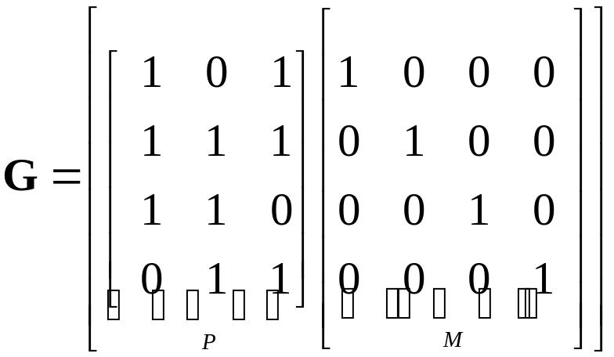

Generating a Hamming code: An example
For the Hamming codes n=2^{r}-1, k = n - r, d_{min}=3
Take the systematic (n,k) Hamming code with r=3 (the number of check bits) and n=2³-1=7 and k=n - r=7-3=4. Therefore the generator matrix is
For a physical realization of the encoder we now assume that the message contains the bits
I

Slide 28

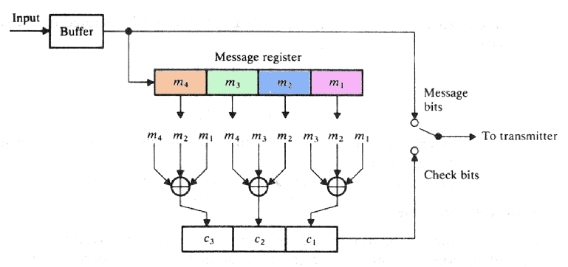
Realizing a (7,4) Hamming code encoder
For these four message bits we have a four element message register implementation
Note that here the check bits [b₁,b₂,b₃] are obtained by substituting the elements of P into equation B=MP or

Slide 29
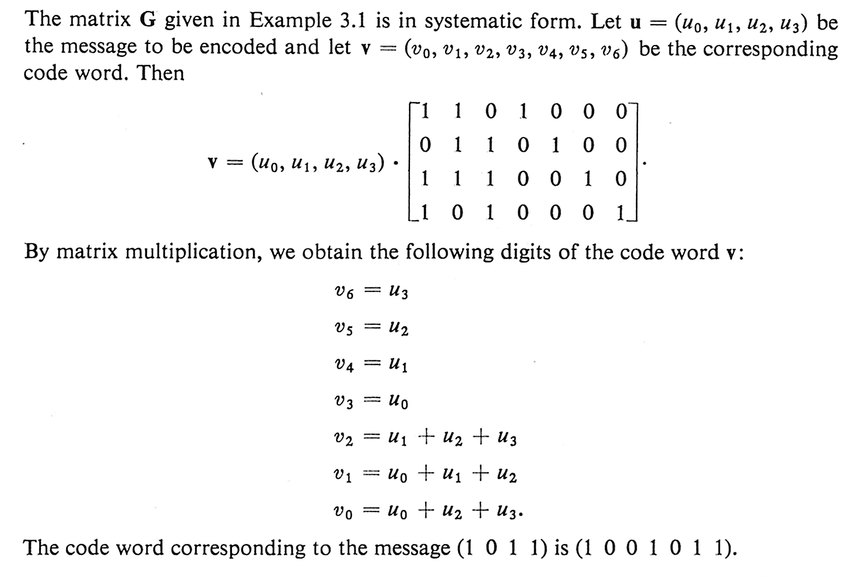
Example*
*S. Lin, E. Costello: Error Control Coding: Fundamentals and Applications

Slide 30
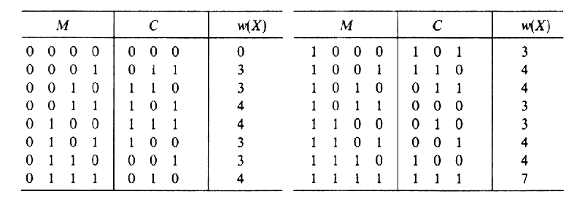
Listing generated Hamming codes
Going through all the combinations of the input vector X yields all the possible output vectors
Note that for the Hamming codes the minimum distance or weight w = 3 (the number of “1” on each row)

Slide 31
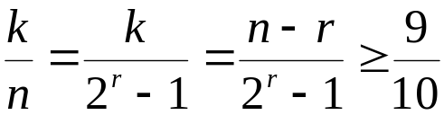

Decoding block codes
A brute-force method for error correction of a block code includes comparison to all possible same length code structures and choosing the one with the minimum Hamming distance when compared to the received code.
In practice applied codes can be very long and the extensive comparison would require much time and memory. For instance, to get the code rate of 9/10 with a Hamming code it is required that
This equation fulfills if the code length is at least k=57, and now n = 63.
There are different block codes in this case! Decoding by direct comparison would be quite unpractical!
This approach of comparing Hamming distance of the received code to the possible codes, and selecting the shortest one is the maximum likelihood detection and is addressed more with convolutional codes

